Slide 1
Mass Spec
Promising Hits from Small Ack Selections
Ian Noonan
3/5/2025

Slide 2
Promising Hits; Origin of Hits
Library: Small AcK Library
Positive Selection Conditions: +10 mM AcK
Fluorescent Selection Conditions: +10 mM AcK
Promising Hits: D9, E2
Library: Small AcK Library
Positive Selection Conditions: +10 mM Propionyl Lysine
Fluorescent Selection Conditions: +10 mM Propionyl Lysine
Promising Hits: C10,F4,H3
Library: Small AcK Library
Positive Selection Conditions: +10 mM Propionyl Lysine
Fluorescent Selection Conditions: +10 mM AcK
Promising Hits: D5, E11

Slide 3
Overview of Hits
E2: + 10 mM Ack, +1 mM Propionyl Lysine
H3: +10 mM AcK, +10 mM Propionyl Lysine
C10: +10 mM AcK, +10 Mm Propionyl Lysine
E11: + 10 mM AcK, +1 mM Propionyl Lysine

Slide 4
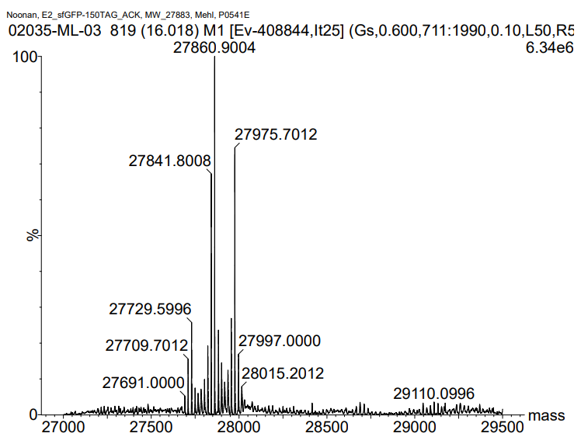
Library: Small AcK Library
Hit: E2
Protein: sfGFP-150TAG
Amino Acid: Grown +10 mM Acetyllysine
Positive Selection Conditions: +10 mM Acetyllysine
Fluorescent Selection Conditions: +10 mM Acetyllysine
27,841.80 – Lysine
27,860.90 – Phenylalanine
27,975.70 – 281 Mw AA

Slide 5
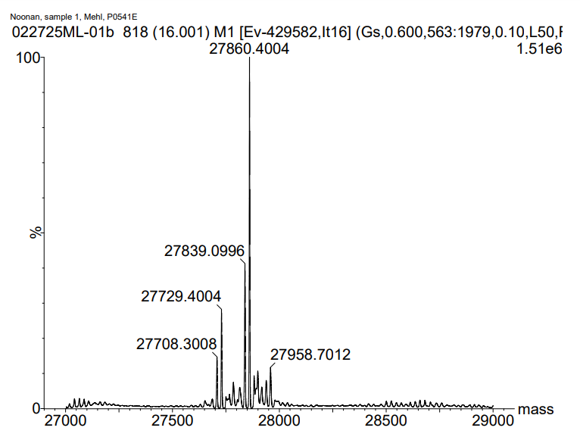
Library: Small AcK Library
Hit: E2
Protein: sfGFP-150TAG
Amino Acid: Grown +1 mM Propionyl Lysine
Positive Selection Conditions: +10 mM Acetyllysine
Fluorescent Selection Conditions: +10 mM Acetyllysine
27,839.09 – Lysine
27,860.90 – Phenylalanine

Slide 6
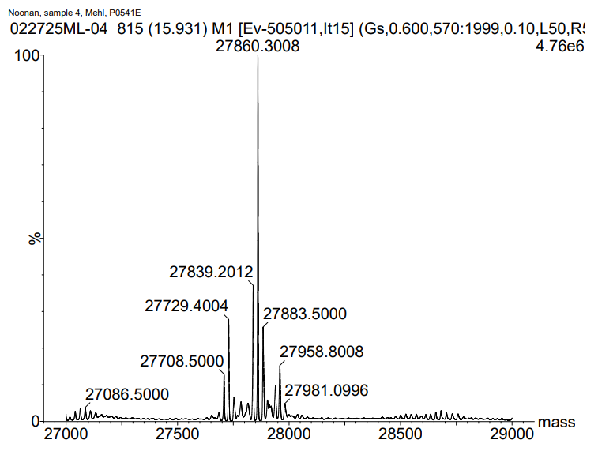
Library: Small AcK Library
Hit: E11
Protein: sfGFP-150TAG
Amino Acid: Grown +10 mM Acetyllysine
Positive Selection Conditions: +10 mM Propionyl Lysine
Fluorescent Selection Conditions: +10 mM Acetyllysine
27,839.20 – Lysine
27,860.30 – Phenylalanine
27,833.50 – Acetyllysine

Slide 7
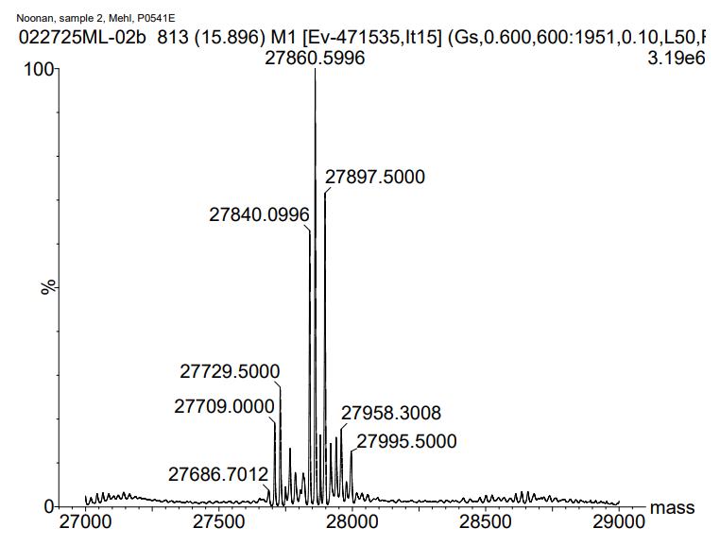
Library: Small AcK Library
Hit: E11
Protein: sfGFP-150TAG
Amino Acid: Grown +1 mM Propionyl Lysine
Positive Selection Conditions: +10 mM Propionyl Lysine
Fluorescent Selection Conditions: +10 mM Acetyllysine
27,840.09 – Lysine
27,860.59 – Phenylalanine
27,897.50 – Propionyl Lysine

Slide 8
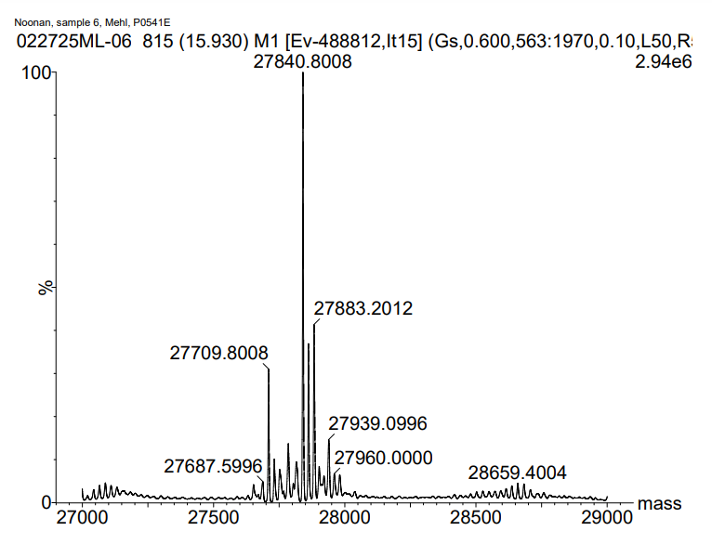
Library: Small AcK Library
Hit: C10
Protein: sfGFP-150TAG
Amino Acid: Grown +10 mM Acetyllysine
Positive Selection Conditions: +10 mM Propionyl Lysine
Fluorescent Selection Conditions: +10 mM Propionyl Lysine
27,840.80 – Lysine
27,883.20 – Acetyllysine

Slide 9
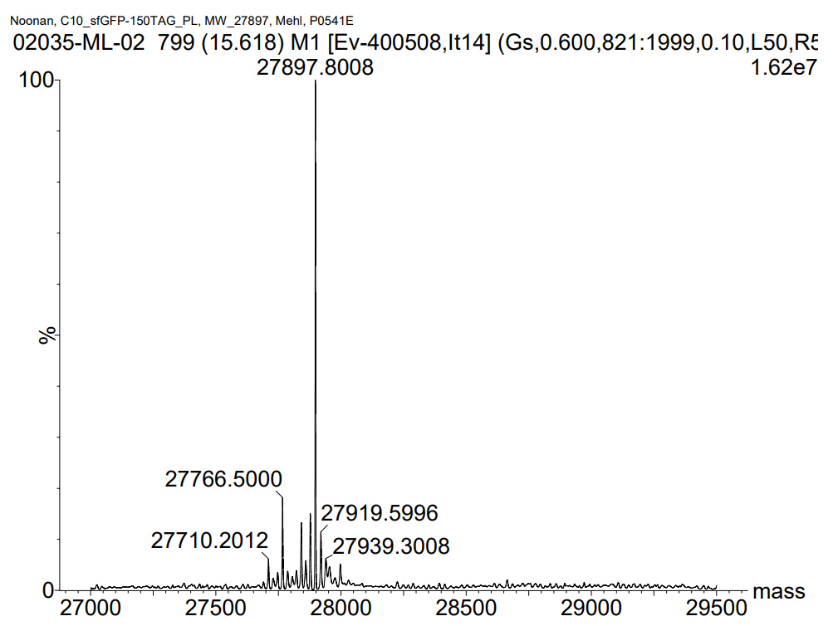
Library: Small AcK Library
Hit: C10
Protein: sfGFP-150TAG
Amino Acid: Grown +10 mM Propionyl Lysine
Positive Selection Conditions: +10 mM Propionyl Lysine
Fluorescent Selection Conditions: +10 mM Propionyl Lysine
27,897.80 – Propionyl Lysine

Slide 10
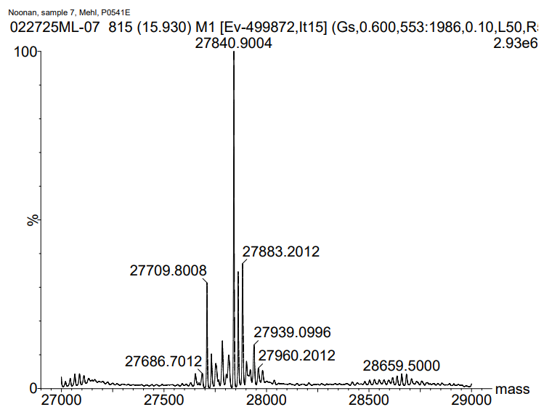
Library: Small AcK Library
Hit: H3
Protein: sfGFP-150TAG
Amino Acid: Grown +10 mM Acetyllysine
Positive Selection Conditions: +10 mM Propionyl Lysine
Fluorescent Selection Conditions: +10 mM Propionyl Lysine
27,840.90 – Lysine
27,883.20 – Acetyllysine

Slide 11
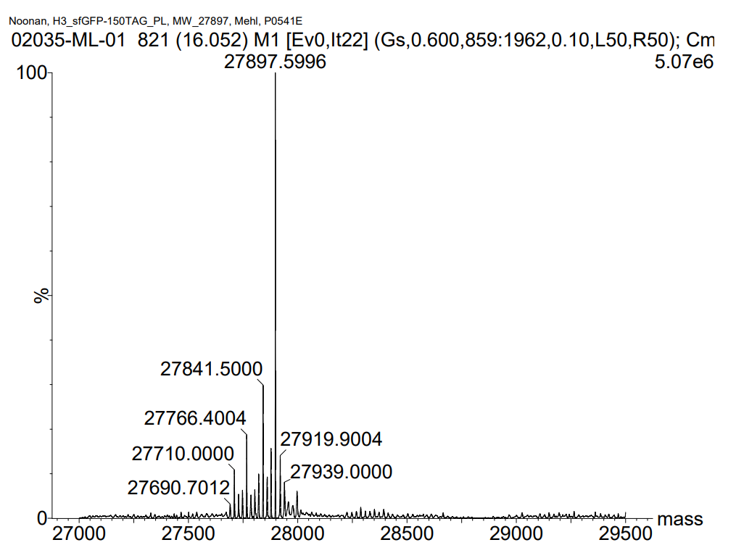
Library: Small AcK Library
Hit: H3
Protein: sfGFP-150TAG
Amino Acid: Grown +10 mM Propionyl Lysine
Positive Selection Conditions: +10 mM Propionyl Lysine
Fluorescent Selection Conditions: +10 mM Propionyl Lysine
27841.50 – Lysine
27,897.80 – Propionyl Lysine

